Slide 1
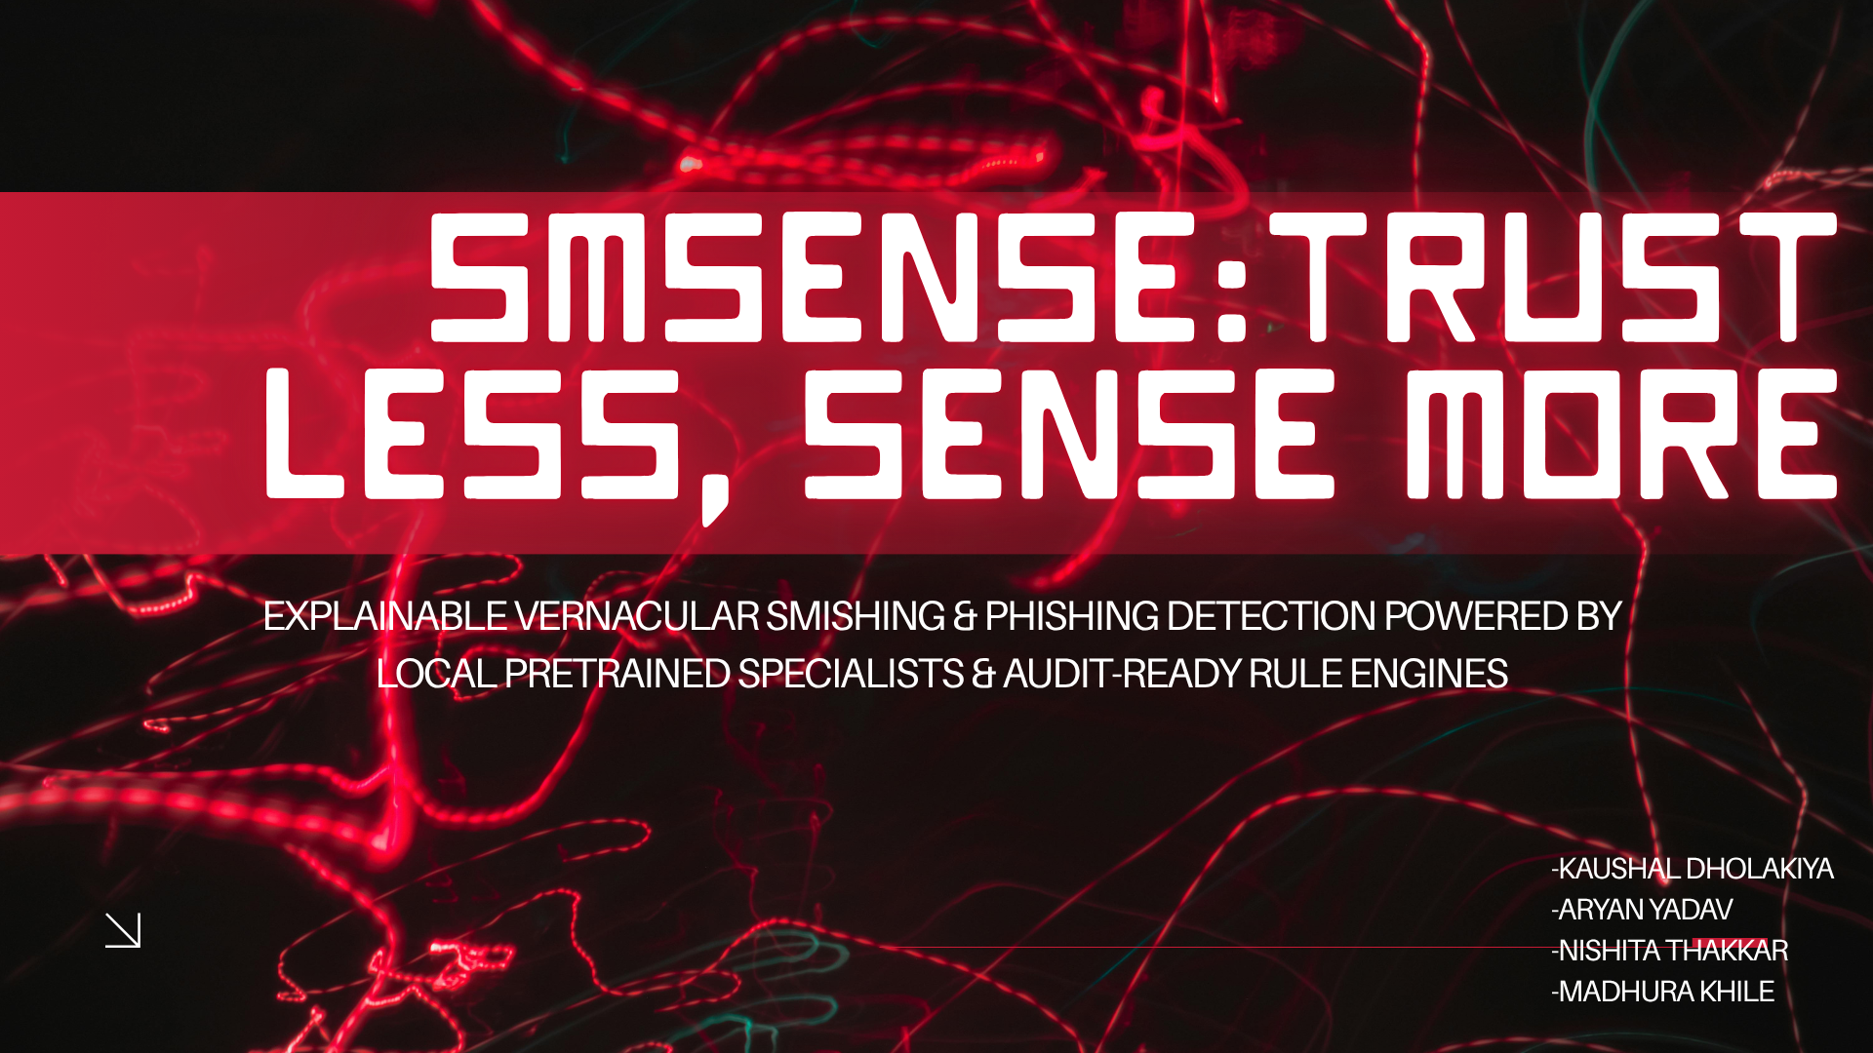
DETECT → PROVE → EXPLAIN

Slide 2
01 / CONTEXT
The Problem
WHAT ATTACKERS DO
OUR SOLUTION
▸ Hinglish Camouflage – Mix Hindi + English to evade static NLP filters
▸ Vernacular Intelligence – Decipher code-mixed scripts and regional slang nuances natively.
▸ Urgency and threats – Manufacture artificial panic
▸ Raw evidence Chain – Preserve pristine, un-normalized raw text for forensic integrity.
▸ Brand Spoofing - Impersonate banks / services
▸ Combine multiple signals
▸ Adversarial Evasion – Use zero-width spaces and typos
▸ Explainable Risk Metrics – Provides clear risk scoring backed by post-hoc reasoning
▸ Deceptive Link
▸ Stay audit-ready

Slide 3
02 / ARCHITECTURE
What We Are Building
INPUT
UNDERSTAND
DETECT
FUSE
SCORE
EXPLAIN
SMS +
sender/header
→
raw +
normalization
→
pretrained
models + rules
→
six evidence
groups
→
rule-based
0–100
→
Qwen3
post-hoc
WHY THIS IS DEFENSIBLE
Every score contribution maps to visible evidence. The LLM explains the decision but cannot change it.
CORE DESIGN RULE: RAW TEXT IS NEVER DISCARDED.

Slide 4
03 / MODELS
Pretrained AI Stack
HinSpam
SilverGuard
Pretrained Hinglish spam / scam classifier.
Input: raw SMS
Best use: code-mixed Roman Hindi.
Pretrained Indian SMS scam classifier.
Input: sender/header + raw SMS
Best use: Indian SMS context.
Qwen3 8B
Qwen3 Embedding
Local LLM used only after scoring:
explain • summarize • highlight phrases • recommend action
Local semantic embedding for similarity,
FAISS lookup, known scam examples
and clustering support.

Slide 5
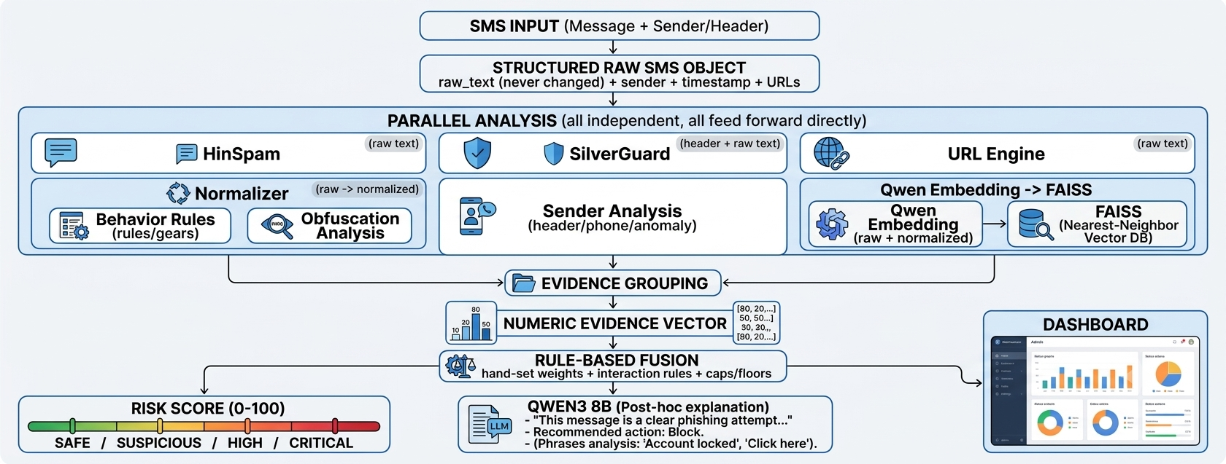
04 / PIPELINE
Final System Architecture
The security decision is ours — through auditable rules.

Slide 6
05 / SCORING
How the Risk Score Works
GROUP
MAX
QUESTION
Content
30
Does the message look like scam/spam?
Sender
15
Does sender context look suspicious?
URL
20
Does the link add risk?
Behavior
20
Is the message manipulating the user?
Obfuscation
10
Is the text trying to evade filters?
Similarity
5
Does it resemble known scam patterns?
No hidden AI score. Six bounded evidence groups → transparent 0–100 result.

Slide 7
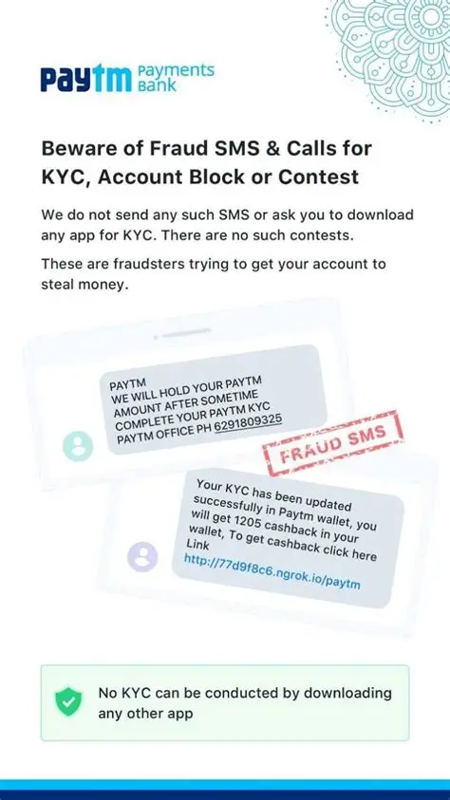
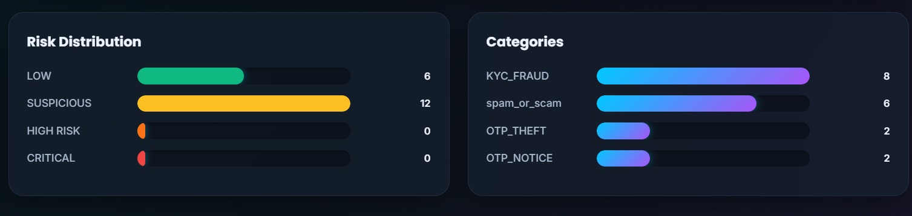
06 / EVIDENCE
Worked Example
“Apka acount blck hoga. KYC upd8 kro: https://sbi-example.xyz”
XX / 100
SENDER +91 98xxxxxx12
NORMALIZATION
EVIDENCE
Aapka account block hoga.
KYC update karo…
acount → account
blck → block
upd8 → update
Content
HIGH
Sender
MEDIUM
URL
HIGH
Behavior
HIGH
Obfuscation
MEDIUM
Similarity
HIGH
HIGH / CRITICAL
RISK SCORE
Exact value tuned on validation data.

Slide 8
07 / EVASION
Killer Feature — Adversarial Robustness
Original
KYC update karo warna account block hoga
✓
Misspelling
KYC updte kro warna accnt blck hoga
✓
Leetspeak
KYC upd8 kro warna acc0unt bl0ck
✓
Symbols
K.Y.C upd@te kro
✓
Mixed
kyc upd8 kr w rna acnt blck
✓
Raw text + character-aware normalization + semantic similarity + context signals
Resilience beyond exact keyword matching.

Slide 9
08 / IMPLEMENTATION
Build Stack & Deployment
AI / NLP
HinSpam • SilverGuard • Qwen3 8B • Qwen3 Embedding 0.6B
All pretrained. Local inference through Hugging Face / Ollama.
BACKEND
Python • FastAPI • Uvicorn • Pydantic • PyTorch • Hugging Face Transformers • ONNX Runtime • FAISS • NumPy • SQLite • REST API • Swagger/OpenAP
FRONTEND
HTML5 • CSS3 • Vanilla JavaScript (ES6+) • Fetch API • REST API • DOM API • AbortController • Google Fonts • Inline SVG
LOCAL-FIRST • No user message needs to be sent to a commercial LLM API for the main pipeline.

Slide 10
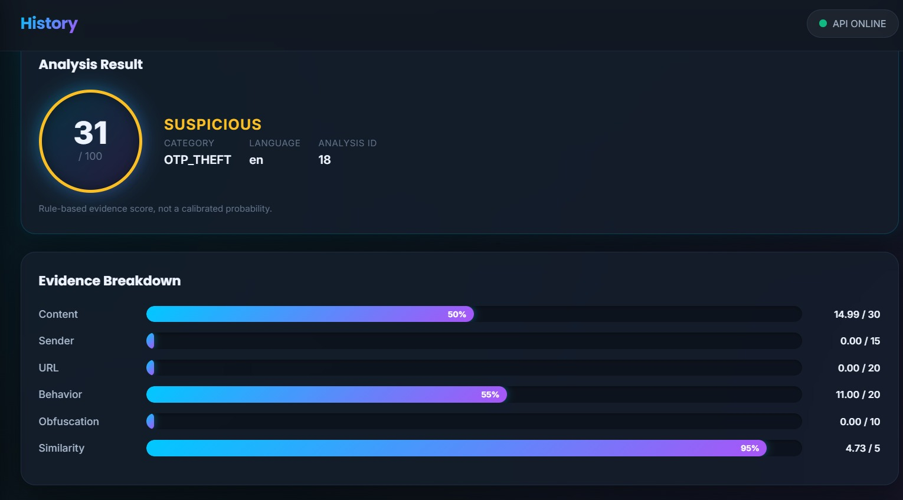
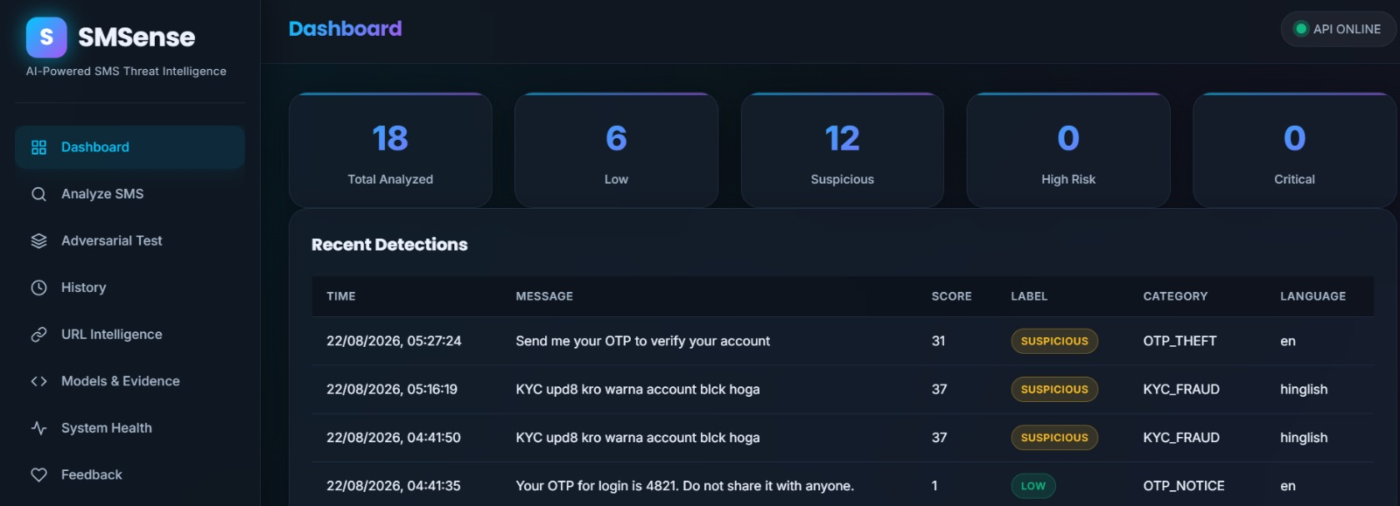
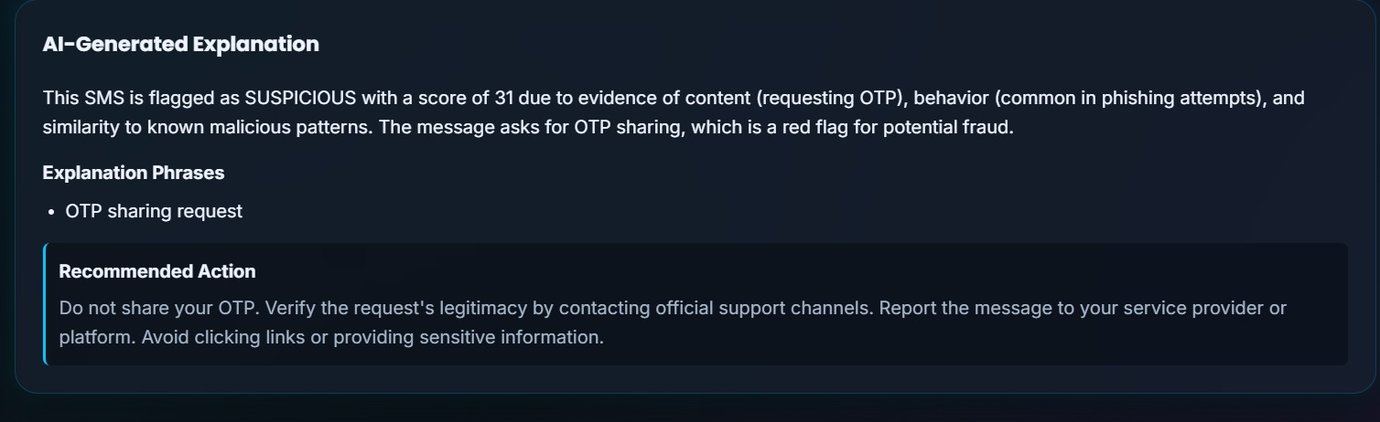
09 / UX
Judge-Friendly Dashboard

Slide 11
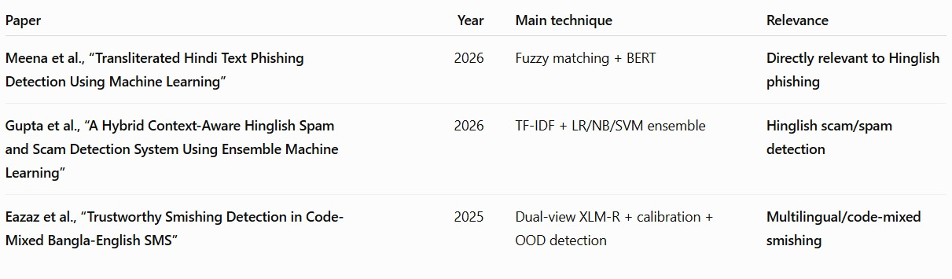
10 / EVALUATION
Past Work
Tools & Systems
PhoneSathi → Hindi + Marathi SMS scam detection + LLM explanation
ScamShield / NeoRakshak → Multilingual (includes Hinglish) multi-signal detection IndicBERT-based open-source detectors
Government tools (Sanchar Saathi) → Reporting, not intelligent classification
Most existing work focuses on classification accuracy. Limited focus on deliberate misspellings + transparent evidence.

Slide 12
11 / DIFFERENTIATION
Why SMSense?
VERNACULAR-FIRST
EVASION-AWARE
EVIDENCE-BASED
Designed around Hinglish / Roman-script scams, not English-only text.
Raw + normalized views catch deliberate misspellings and obfuscation.
Six evidence groups make every score explainable.
PRETRAINED-ONLY
LOCAL & PRACTICAL
JUDGE-READY
No rushed model training; models are used as proven specialists.
Ollama + lightweight classifiers + FAISS + SQLite.
Live demo shows detection, evidence, explanation and adversarial testing.

Slide 13
Current Limitations | Future Scope
Limited Hinglish Dataset More diverse Indian-language scam data is needed for broader coverage | Extend SMSense to major Indian Multilingual Expansion languages and code-mixed text.
Evolving Scam Patterns - New scam tactics and obfuscation techniques require continuous updates | Continuous Learning - Incorporate user feedback and newly identified scams to improve detection.
Limited URL Intelligence - Current analysis focuses on URL characteristics rather than live threat reputation. | Real-Time Threat Intelligence - Integrate live URL/domain reputation services for stronger verification.

Slide 14
Thankyou!
SMSENSE • TRUST LESS, SENSE MORE

